Slide 1
Analysis of Sports Gambling in the U.S.
Michael Alberts
Jeffrey Bridges
Ryan Hartquist
Andrew Kuchel

Slide 2
Overview
BACKGROUND HISTORY
Federal law in 1992 prohibited most states from authorizing sports betting
Supreme Court ruling in 2018 overturned law
SINCE RULING
18 states have legalized and operational sports betting
4 more states have legalized without operations
9 more states have active state bills
12 more states have failed legislation

Slide 3
Project Objectives
Identify trends and growth in revenue from sports betting
Compare and analyze additional revenue generated in states with legalized sports betting
Prepare a model to evaluate potential revenue in new states
Compare and analyze the demographics between states
Use sports revenue compared to overall revenue
Identify best model
Use known state data
Use model to predict revenue for states that have yet to legalize or operate

Slide 4


Data - Access
The variables of this project:
Identify trends and growth in revenue from sports betting
Prepare a model to evaluate potential revenue in new states
https://www.legalsportsreport.com/
Handle
Bet Revenue
Hold %
Taxes
https://www.taxadmin.org
Total Tax Revenue
Per Capita Taxes
https://www.kff.org/
Population demographics
https://en.wikipedia.org/wiki/List_of_U.S._states_and_territories_by_income
Data based on age bracket

Slide 5
Data – Consolidation and Cleaning
Data Consolidation
Data Cleaning
Most consolidation performed by scripts
While gathering data, not after the fact
State Name used as primary key to correctly merge data frames
Removal of U.S. Territories and Washington D.C. done manually
Very few missing values
Convert scraped data from ‘Character’ to ‘Numeric’
Performed on every column of data besides State Name
Created two complete data frames to be used for analysis
1st data frame related to Sports Gambling Revenues/Taxes
2nd data frame related to State Demographics

Slide 6
Data – Transformation and Reduction
Data Transformation
Data Reduction
Created variables to calculate % of sports betting in relation to total tax
Summed up sports gambling tax per state, per year and merged data frames
Removal of Nevada from any further analysis
Nevada has had legalized gambling since 1949, skewing data significantly

Slide 7
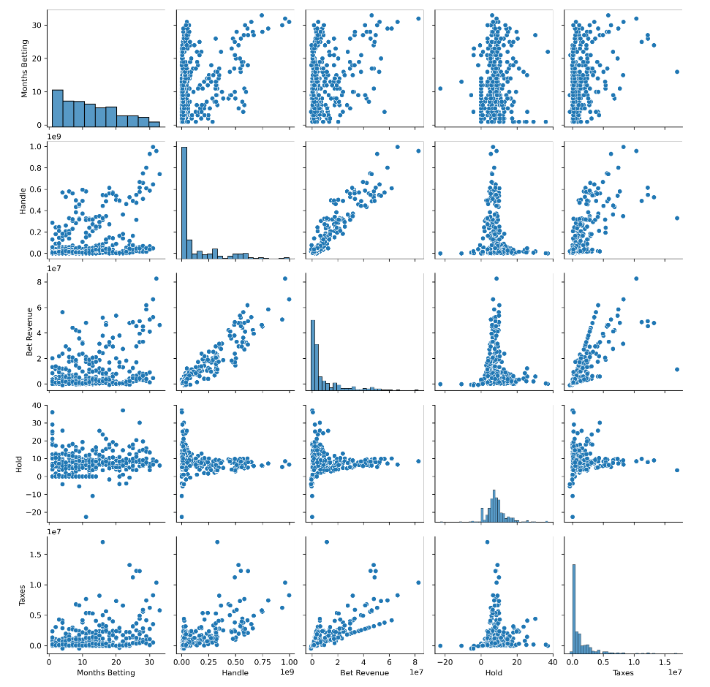
Visualization and Analysis

Slide 8
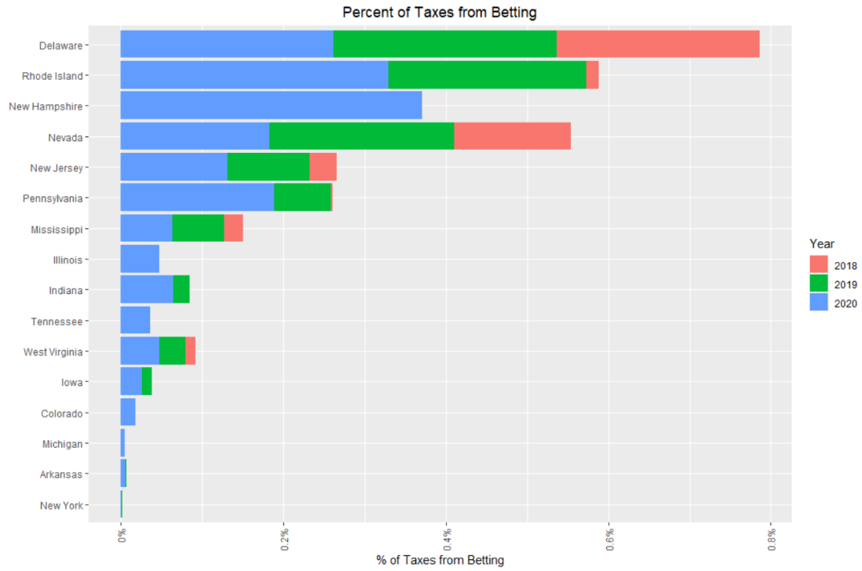
Visualization and Analysis

Slide 9
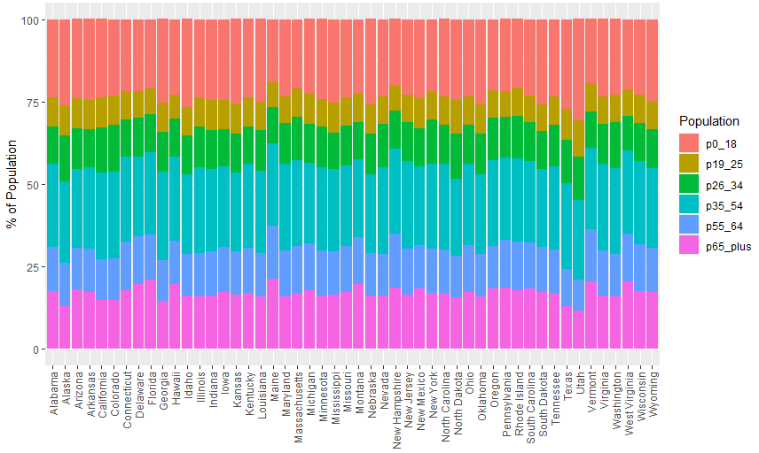
Visualization and Analysis

Slide 10
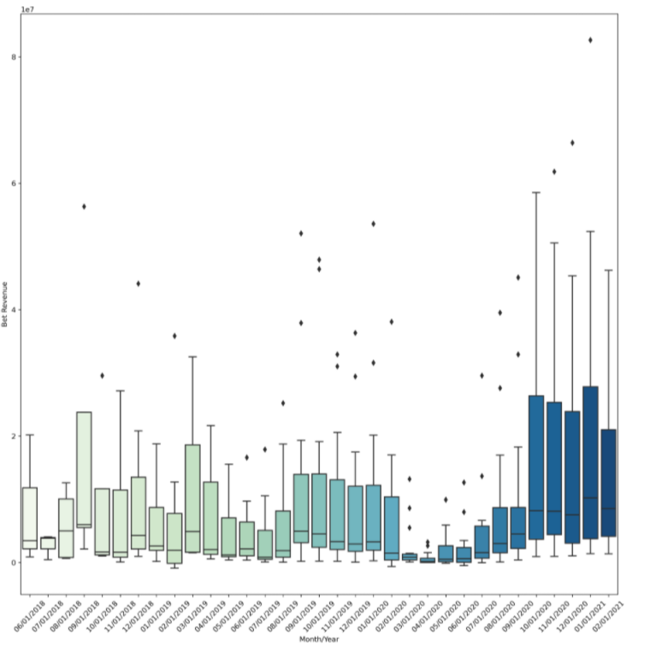
Visualization and Analysis

Slide 11


Model Results
Linear Regression
Neural Network
XGBoost
Regression lowest overall model on all metrics
XGBoost model performs well on training, but overfitting
Neural Network performs best as the most well-rounded

Slide 12
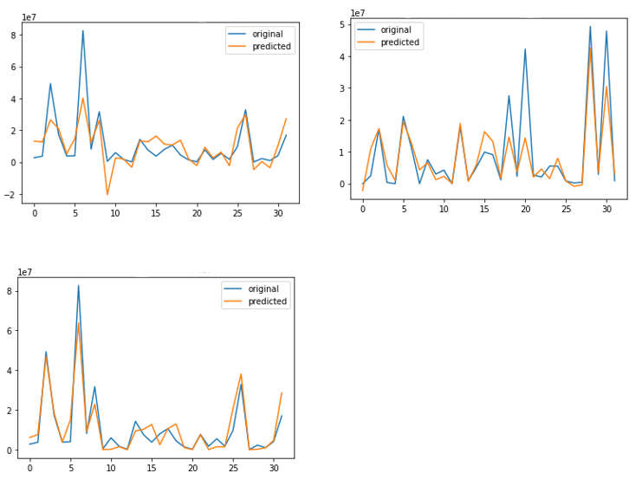
Model Results
Linear Regression
XGBoost
Neural Network
LR tends to under fit on most points
NN picks up much more of the nuance that other models
XGBoost predicts lower values well, but struggles where months have high bet revenue

Slide 13
Model Results
Linear Regression
Neural Network
XGBoost
Works best with our non-linear data
Better goodness of fit on validation and test
Minimizing error is most important for revenue prediction

